Slide 1

CASE STUDY PRESENTATION ON
SALES PREDICTION OF BIG MART BASED ON LINEAR REGRESSION, RANDOM FOREST, AND GRADIENT BOOSTING
GUIDED BY : PROF:TIM WEBER
Presented by:
Arshita Thummar (12402540)
Ravi Virani (22307118)
Ranveer Patil (22305107)
Allan Johns (22304075)
Nevil Rafaliya ( 22305913)

Slide 2

CONTENTS:
Introduction
Objective
Data & method
Metrics
Models
Feature and co-relation analysis
Result
Conclusion

Slide 3

Sales forecasting is essential for businesses to make informed decisions about inventory, pricing, and marketing.
Machine learning can be used to create sales forecasting models that are more accurate than traditional methods.
This paper examines the use of machine learning for sales forecasting in Big Mart.
INTRODUCTION

Slide 4
Evaluate the performance of Linear Regression, Random Forest, and Gradient Boosting in sales prediction
Use RMSE, MAE, and R² score as performance metrics
Provide guidelines for small retailers on effective sales predictions
Objective

Slide 5
Data source:
Kaggle dataset on Big Mart sales (1559 products, 10 stores, 2013)
Dependent variable:
Sales of each product at each store
Independent variables:
Categorical (7):
product ID, fat content, product type, outlet ID, outlet size, location type, outlet type
Numerical (4):
weight, visibility, maximum retail price (MRP), year of establishment
Data processing
Train-test split (80%/20%)
Handling missing values (weight, outlet size)
Combining redundant categories (fat content)
Converting categorical variables to indicator variables
Data & Method

Slide 6
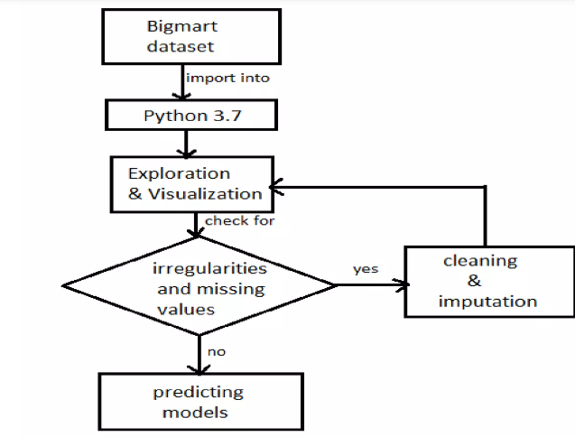
Work Flow

Slide 7



The metrics used to determine the performance of models were Root Mean Square Error (RMSE), Mean Absolute Error (MAE), and the coefficient of determination (R2).
Root Mean Square Error (RMSE) is a metric used to evaluate how well a forecasting model performs. It tells you how close the predictions are to the actual values.
Mean Absolute Error (MAE) is a way to measure the average size of the errors between predicted and actual values. It focuses on the magnitude of the error.
Coefficient of determination (R²) is a statistical measure used in regression analysis to assess how well a model explains the relationship between a dependent variable and one or more independent variables.
Metrics

Slide 8
Linear regression:
linear regression model with ordinary least squares (OLS) method was used. This model assumes that the relationship between the dependent variable y and the independent variable x is linear, and generates the set of coefficients 𝛽𝑖’s which minimizes the residual sum of squares between the ob served values in dataset and the targets predicted by the model. Here, the intercept term was included to achieve better result. The formular is as following:
Random forest:
Random Forest is an ensemble learning method that operates by building a number of decision trees at training time and uses averaging to improve prediction accuracy and reduce overfitting.
Gradient boosting:
Gradient Boosting is a method of combining several simple models, which are typically decision trees, into a composite model.
Models

Slide 9
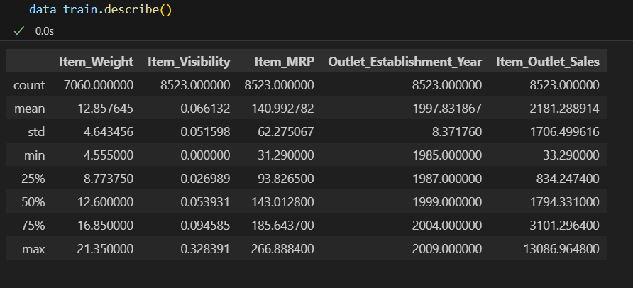
Dealing with missing values in a dataset
Data before handling the missing values

Slide 10
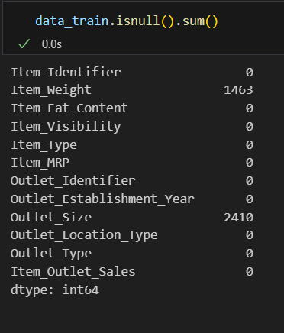
Dealing with missing values in a dataset
Data before handling the missing values

Slide 11
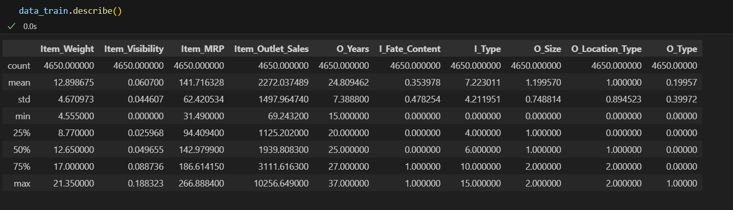
Dealing with missing values in a dataset
Data after handling the missing values

Slide 12
Dealing with missing values in a dataset
1. Preservation of Data Integrity:
By removing rows with missing values, you ensure that the remaining data is complete and not artificially modified. This helps maintain the original distribution and relationships within the data.
2. Avoiding Imputation Bias:
Imputation (filling missing values with mean, median, mode, etc.) introduces an element of bias, especially if a large portion of the dataset has missing values. This bias can affect the performance and accuracy of your models.
3. Suitable for Small Proportion of Missing Data:
Dropping rows is particularly advantageous when the proportion of missing data is small, as it has a minimal impact on the overall dataset and the information retained.
4. Avoiding Invalid Assumptions:
Imputation methods often assume that the missing data is randomly distributed (Missing Completely At Random - MCAR), which might not always be true. Dropping rows avoids making such assumptions.

Slide 13
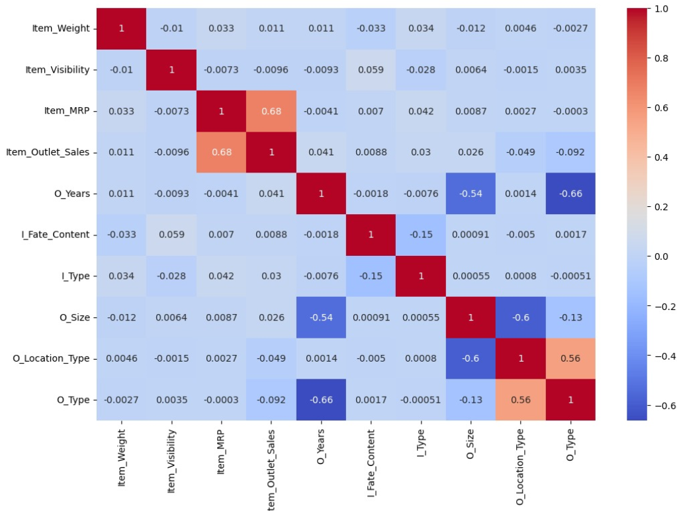
HEATMAP OF CORRELATION COEFFICIENT
Feature
Choose appropriate features and train the models.
Features were selected based on their correlation with the target variable. In the calculation of correlation coefficients, cramér’s V (also known as cramér’s φ), the statistic that meas used the association between nominal variables
Correlation Analysis
Heatmap of correlation coefficients
High correlation: MRP and outlet type
Low correlation: weight, fat content, year of establishment

Slide 14
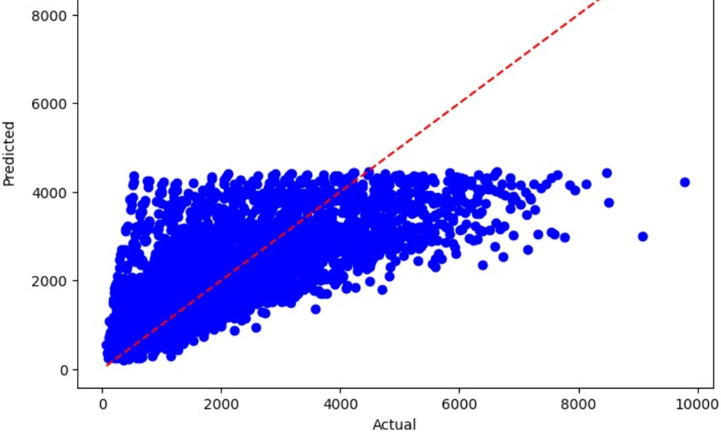
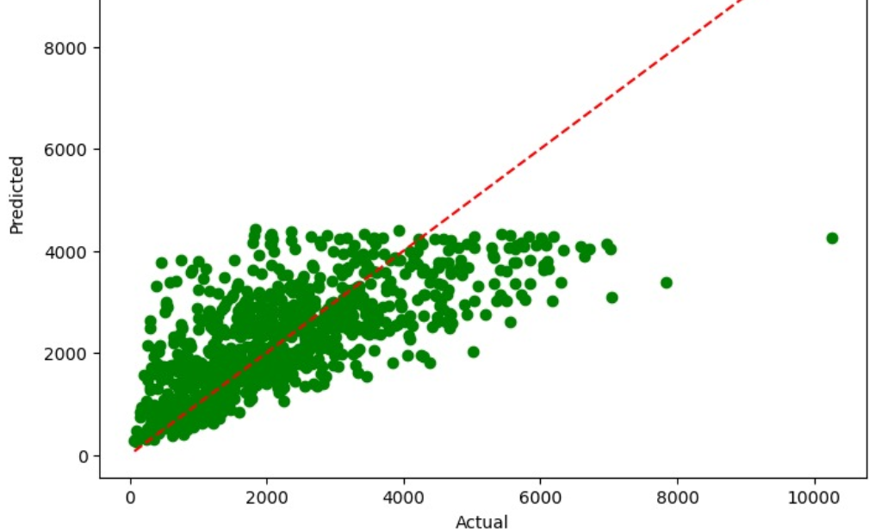
SCATTER PLOT FOR LINEAR REGRESSION RESULT
It has a low R squared as the data is more scattered around the line in test data
As actual sales values increase, the predicted values also increase, but not in a perfectly linear fashion.
The overall pattern shows that the model has difficulty capturing the true relationship between features and sales values.

Slide 15
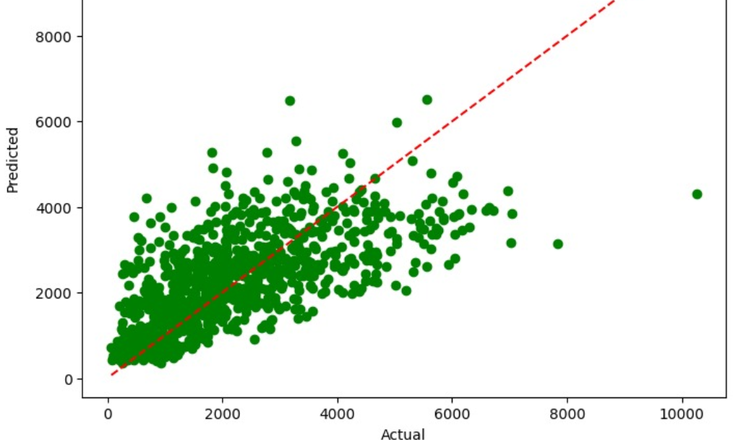
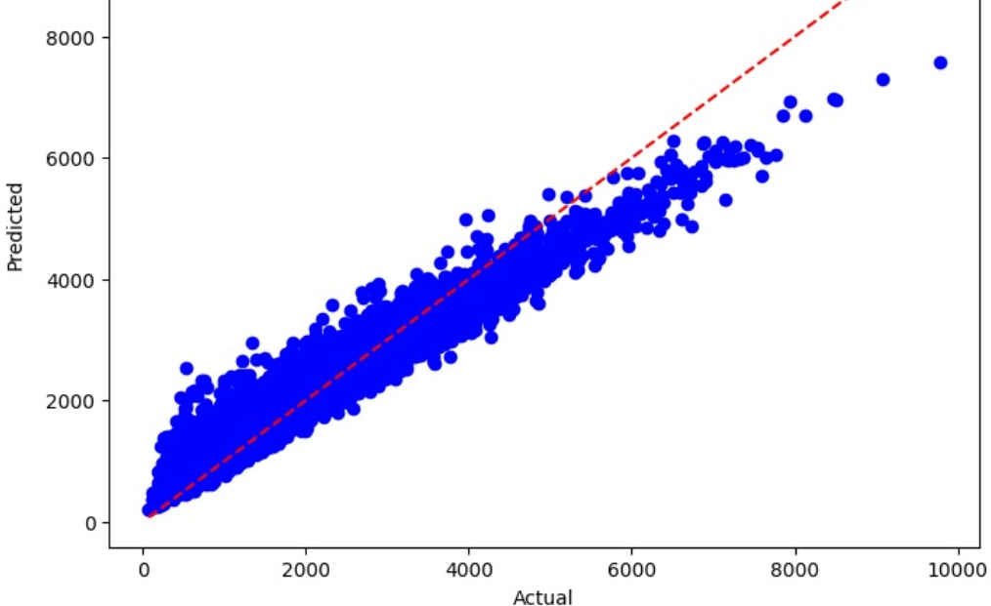
SCATTER PLOT FOR RANDOM FOREST RESULT
The Random Forest model shows better performance compared to the linear regression model, with predictions that are closer to the actual values.
For the test data, the green dots are more aligned with the red dashed line, indicating more accurate predictions and less spread.
For the training data, the blue dots are tightly clustered around the red dashed line, indicating that the model fits the training data very well.

Slide 16
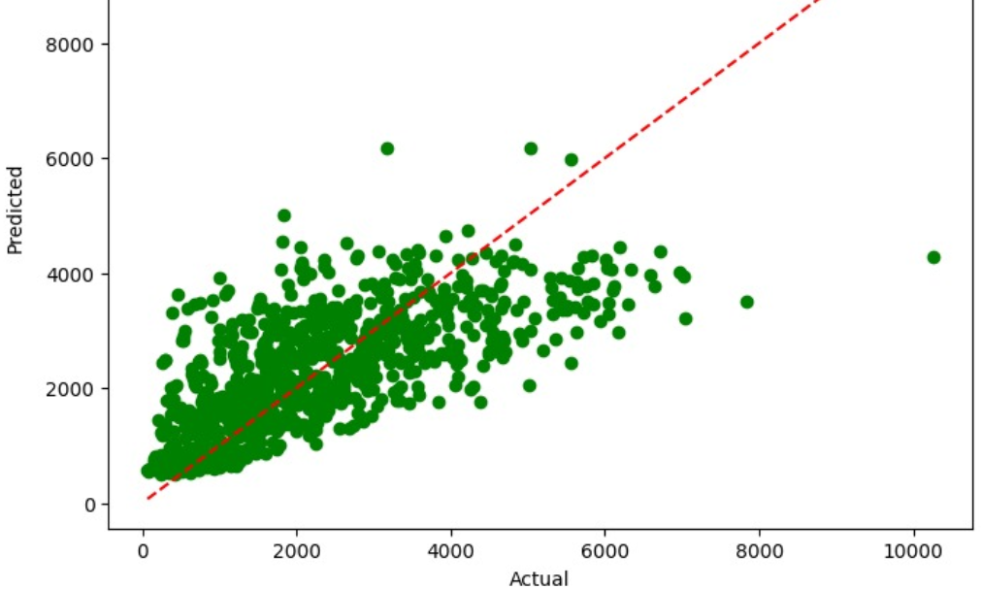
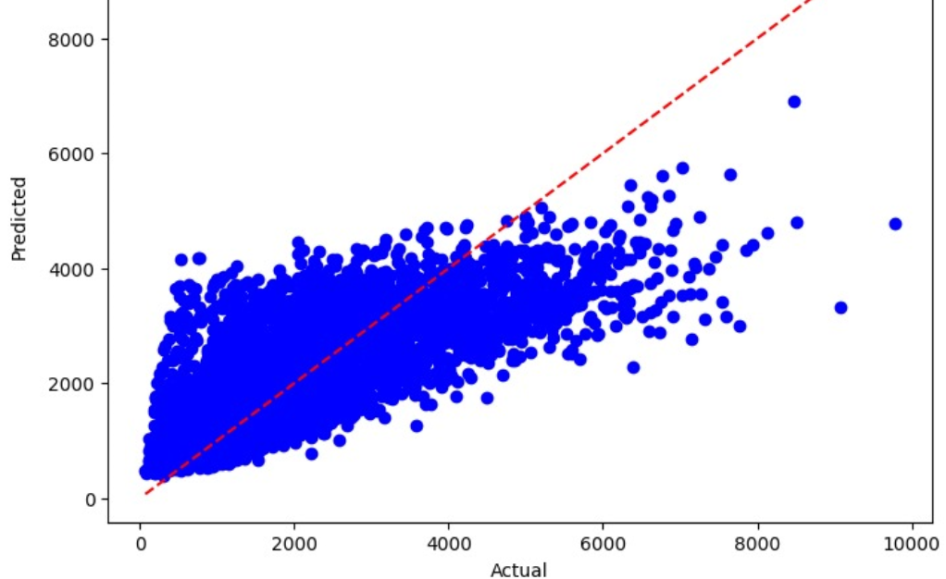
SCATTER PLOT FOR GRADIENT BOOSTING RESULT
Slightly better performance than random forest. It has a high R squared in test data.
For the test data, the green dots are more aligned with the red dashed line, indicating more accurate predictions and less spread.
Overall, this model is better at capturing the relationship between the features and sales values, leading to improved prediction accuracy.

Slide 17
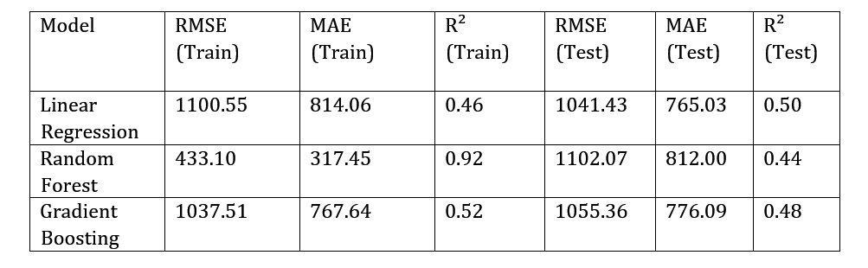
RESULT
Gradient boosting achieves the highest R² and lowest errors in testing
Random forest performs slightly worse than gradient boosting
Linear regression has the worst accuracy

Slide 18
Gradient boosting performed best among the three models for sales prediction in big mart.
CONCLUSION
Machine learning for sales prediction with small datasets is feasible but not ideal.

Slide 19

THANK YOU

